Slide 1
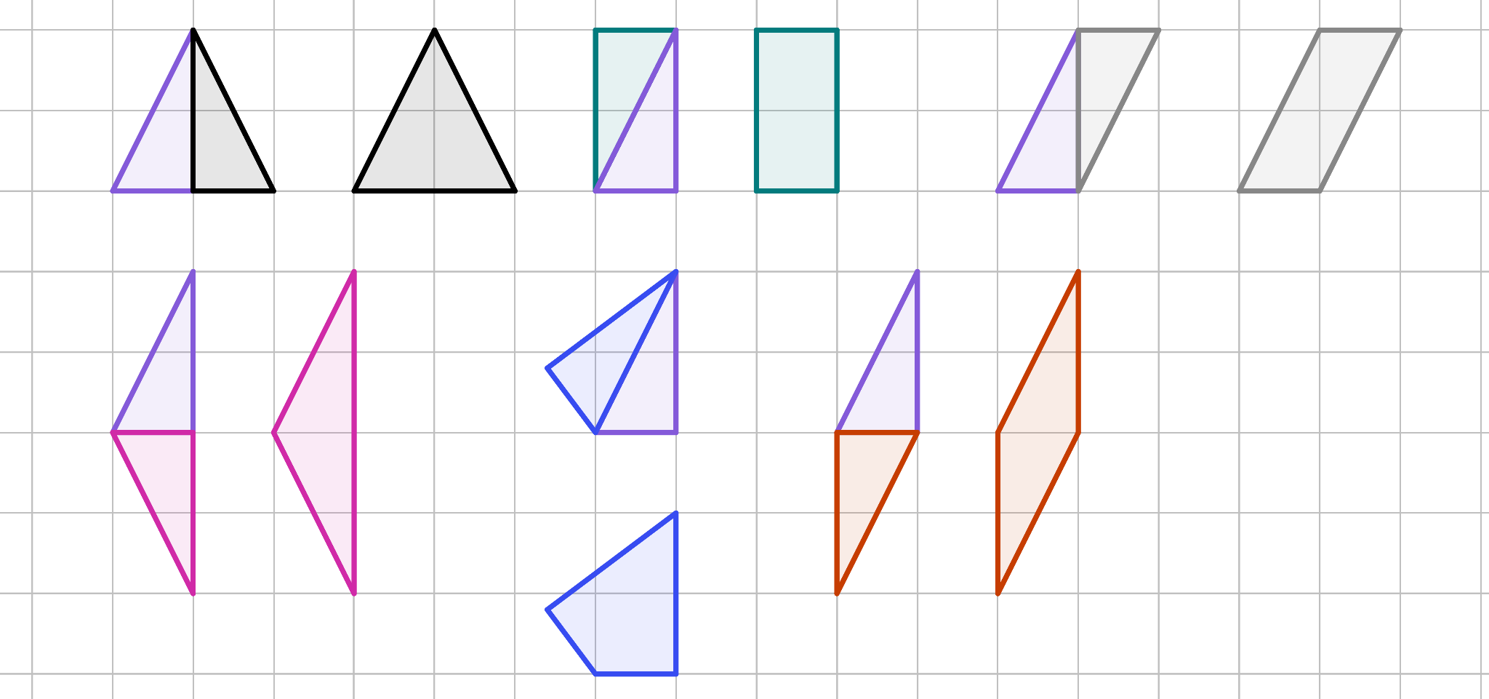
Transformed objects
Task A: Which transformation?
By considering the changes, decide which transformation could have taken place in each case. There might be more than one.
the lengths have changed
the sense has changed
the orientation has changed
the position has changed
enlargement
reflection
reflection or rotation
all
By considering the invariant properties, decide which transformation could not have taken place in each case. There might be more than one.
the lengths are invariant
the sense is invariant
the orientation is invariant
the angles are invariant
not an enlargement
not a reflection
neither reflection nor rotation
none (since all 4 transformations you are familiar with have invariant angles!)
Identify the type of transformation that has taken place to create the new shape.
a)
b)
c)
reflection
rotation
rotation
d)
e)
f)
reflection
reflection
rotation

Slide 2
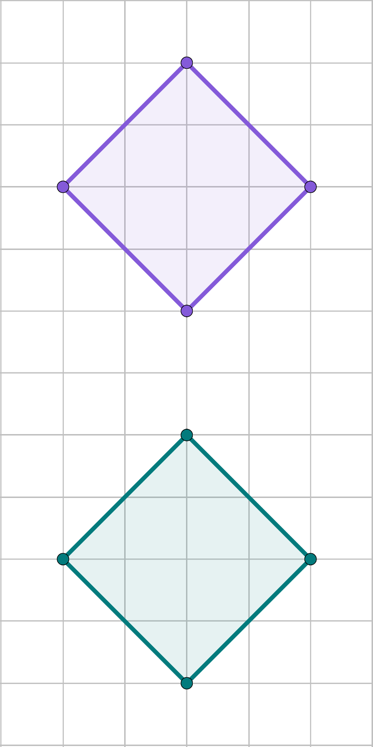
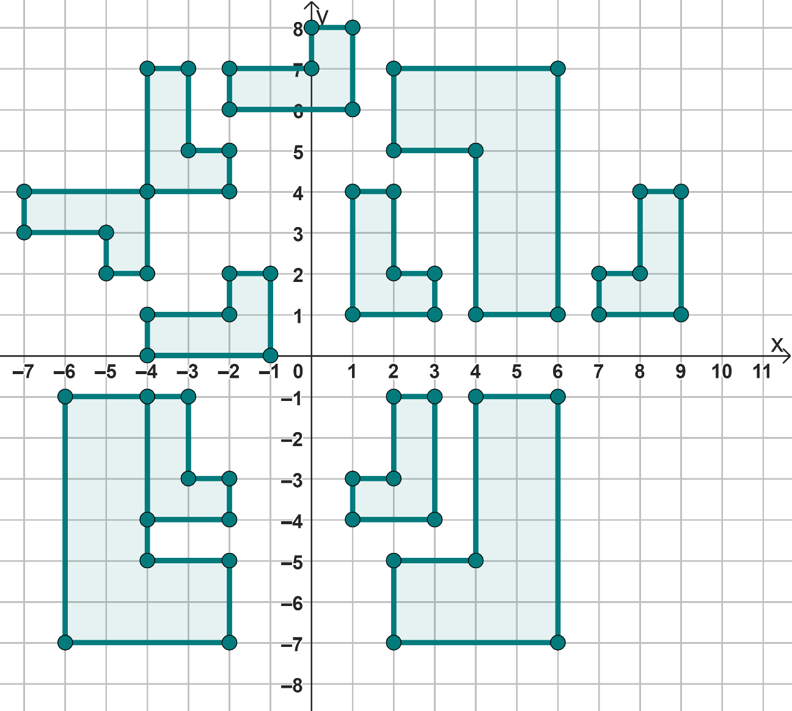
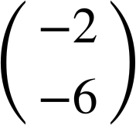


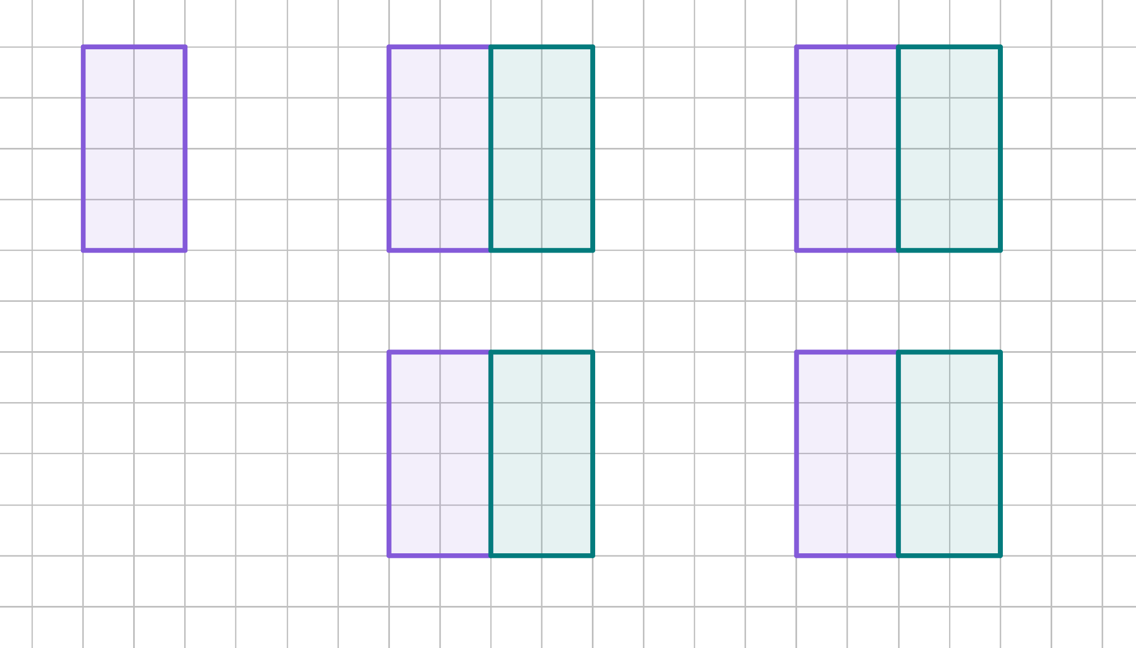

Transformed objects
Add the image vertices labels.
After a vertical reflection
After a translation
After a 180° rotation
D
D
D
A
C
A
C
A
C
B
B
B
B′
D′
B′
A′
C′
A′
C′
C′
A′
D′
B′
D′
Task B: Recognising and describing transformations
Complete the descriptions.
A
B
C
Shape A has been reflected in a diagonal line passing through (-3, 3) and (1, -1) onto shape D.
D
F
E
G
Shape J has been reflected in the y-axis onto shape K.
H
I
Shape B has translated by
onto shape E.
J
K
Shape H has been enlarged by scale factor 2 from (-2, -1) onto shape J.
Shape H has translated by __ onto shape A.
Shape C has been rotated 180° about the origin onto shape J.
Three different transformations have taken place to create the image, which combined makes a square.
What are they?
1) Translate by
2) Reflect along the right edge of the shape.
3) Rotate 180° around the midpoint of the right edge.
Mathematics in Education and Industry.

